Slide 1
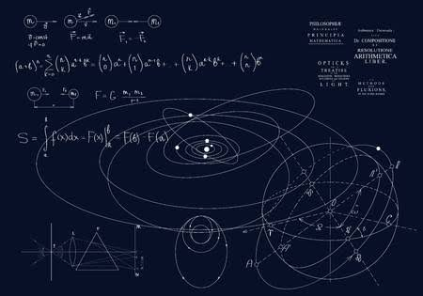
Yashwantrao chavan, Mahavidyaly Islampur
Bsc II (PHYSICS)
SEM III. paper V
Thermal physics & statistical mechanics - I
By
Miss. Dhotre. A. P
( M.Sc.phsyics)

Slide 2
Syllabus (paper- v) Thermal physics & statistical mechanics - I
Unit I
kinetic theory of gases and thermometry
Unit II
Law of Thermodynamics

Slide 3
Unit 2 Law of thermodynamics
2.1: Introduction
Thermodynamics is branch of physics which deals with the interconversion between heat energy and other forms of energy

Slide 5
There are four fundamental laws, by which interconversion can be explained.
Thermodynamics deals with the behavior of macroscopic system only
i .e. system containing large number
of molecules.
It also do not take consideration the time factor in various transformation from one State to another.

Slide 6
2.2 : Thermodynamics system and thermodynamics variables
When change of any type occurs in material by exchanging heat, the material is called thermodynamic system
All other things outside the system called the surrounding.

Slide 7
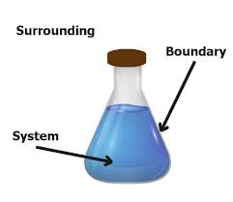

Slide 8
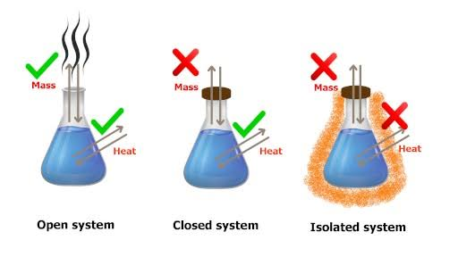

Slide 9
Thermodynamic variables
When thermodynamic system undergoes change, like an expansion or contraction ,it can be described by Change in some variables
They are :
Pressure (P)
Volume (V)
Temperature (T)
Entropy (S)
these variables are called the thermodynamic co-ordinates

Slide 10
Eg: 1. When wire is stretched- The thermodynamic coordinates are Temperature (T) Surface tension (f) Length of wire (l)
A
B
A
B

Slide 11
2. Gas contained in vessel -
Thermodynamic coordinates are
Pressure (P)
Volume (V)
Temperature (T)
Piston

