Slide 1
BCA Part-1 SEM-II Subject: Operating System
Unit-1: Introduction of Operating System
Prof. Ashok Sadavare _{(M.C.A., M.Phil., SET)}
_{E-mail: ashokskarad@gmail.com}
_{Mob. No.: 9860078870}

Slide 2
Unit-1 Content
Definition
Objectives
Functions
Generations of OS
Types of OS
Structures of OS
Introduction to Programming using ‘C’
-- Prof. Ashok Sadavare

Slide 3
1. Definition O.S.
An operating system is a program that acts as an interface between the software and the computer hardware.
It is an integrated set of specialized programs used to manage overall resources and operations of the computer.
It is a specialized software that controls and monitors the execution of all other programs that reside in the computer, including application programs and other system software.
An operating system falls under the category of system software that performs all the fundamental tasks like file management, memory handling, process management, handling the input/output, and governing and managing the peripheral devices like disk drives, networking hardware, printers, etc.
Operating Systems are Linux, Windows, OS X, Solaris, OS/400, Chrome OS, Android Operating System, etc.

Slide 4
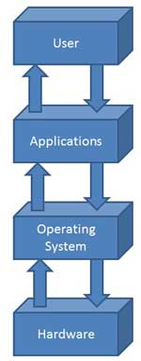
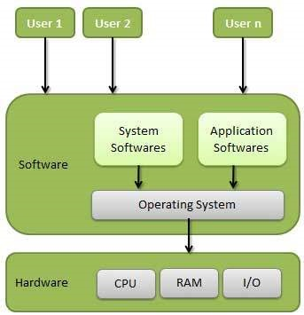
1. Definition of O.S.
-- Prof. Ashok Sadavare

Slide 5
2. Objectives of O.S.
To make the computer system convenient to use in an efficient manner.
To hide the details of the hardware resources from the users.
To provide users a convenient interface to use the computer system.
To act as an intermediary between the hardware and its users, making it easier for the users to access and use other resources.
To manage the resources of a computer system.
To keep track of who is using which resource, granting resource requests, and mediating conflicting requests from different programs and users.
To provide efficient and fair sharing of resources among users and programs.
-- Prof. Ashok Sadavare

Slide 6
3. Functions of O.S.
Memory Management
Memory management refers to management of Primary Memory or Main Memory. Main memory is a large array of words or bytes where each word or byte has its own address.
Main memory provides a fast storage that can be accessed directly by the CPU. For a program to be executed, it must in the main memory.
An Operating System does the following activities for memory management −
Keeps tracks of primary memory, i.e., what part of it are in use by whom, what part are not in use.
In multiprogramming, the OS decides which process will get memory when and how much.
Allocates the memory when a process requests it to do so.
De-allocates the memory when a process no longer needs it or has been terminated.
-- Prof. Ashok Sadavare

Slide 7
3. Functions of O.S.
Processor Management
In multiprogramming environment, the OS decides which process gets the processor when and for how much time. This function is called process scheduling.
An Operating System does the following activities for processor management −
Keeps tracks of processor and status of process. The program responsible for this task is known as traffic controller.
Allocates the processor (CPU) to a process.
De-allocates processor when a process is no longer required.
-- Prof. Ashok Sadavare

Slide 8
3. Functions of O.S.
Device Management
An Operating System manages device communication via their respective drivers. It does the following activities for device management −
Keeps tracks of all devices. Program responsible for this task is known as the I/O controller.
Decides which process gets the device when and for how much time.
Allocates the device in the efficient way.
De-allocates devices.
-- Prof. Ashok Sadavare

Slide 9
3. Functions of O.S.
File Management
A file system is normally organized into directories for easy navigation and usage. These directories may contain files and other directions.
An Operating System does the following activities for file management −
Keeps track of information, location, uses, status etc. The collective facilities are often known as file system.
Decides who gets the resources.
Allocates the resources.
De-allocates the resources.
-- Prof. Ashok Sadavare

Slide 10
3. Functions of O.S.
Other Important Activities
Following are some of the important activities that an Operating System performs −
Security − By means of password and similar other techniques, it prevents unauthorized access to programs and data.
Control over system performance − Recording delays between request for a service and response from the system.
Job accounting − Keeping track of time and resources used by various jobs and users.
Error detecting aids − Production of dumps, traces, error messages, and other debugging and error detecting aids.
Coordination between other softwares and users − Coordination and assignment of compilers, interpreters, assemblers and other software to the various users of the computer systems.
-- Prof. Ashok Sadavare

Slide 11
4. Generation of O.S.
-- Prof. Ashok Sadavare

Slide 12
4. Generation of O.S.
The First Generation ( 1945 - 1955 ): Vacuum Tubes and Plugboards
Digital computers were not constructed until the second world war. Calculating engines with mechanical relays were built at that time. However, the mechanical relays were very slow and were later replaced with vacuum tubes. These machines were enormous but were still very slow.
These early computers were designed, built and maintained by a single group of people. Programming languages were unknown and there were no operating systems so all the programming was done in machine language. All the problems were simple numerical calculations.
By the 1950’s punch cards were introduced and this improved the computer system. Instead of using plugboards, programs were written on cards and read into the system.
-- Prof. Ashok Sadavare

Slide 13
4. Generation of O.S.
The Second Generation ( 1955 - 1965 ): Transistors and Batch Systems
Transistors led to the development of the computer systems that could be manufactured and sold to paying customers. These machines were known as mainframes and were locked in air-conditioned computer rooms with staff to operate them.
The Batch System was introduced to reduce the wasted time in the computer. A tray full of jobs was collected in the input room and read into the magnetic tape. After that, the tape was rewound and mounted on a tape drive. Then the batch operating system was loaded in which read the first job from the tape and ran it. The output was written on the second tape. After the whole batch was done, the input and output tapes were removed and the output tape was printed.
-- Prof. Ashok Sadavare

Slide 14
4. Generation of O.S.
The Third Generation ( 1965 - 1980 ): Integrated Circuits and Multiprogramming
Until the 1960’s, there were two types of computer systems i.e the scientific and the commercial computers. These were combined by IBM in the System/360. This used integrated circuits and provided a major price and performance advantage over the second generation systems.
The third generation operating systems also introduced multiprogramming. This meant that the processor was not idle while a job was completing its I/O operation. Another job was scheduled on the processor so that its time would not be wasted.
-- Prof. Ashok Sadavare

Slide 15
4. Generation of O.S.
The Fourth Generation ( 1980 - Present ): Personal Computers
Personal Computers were easy to create with the development of large-scale integrated circuits. These were chips containing thousands of transistors on a square centimeter of silicon. Because of these, microcomputers were much cheaper than minicomputers and that made it possible for a single individual to own one of them.
The advent of personal computers also led to the growth of networks. This created network operating systems and distributed operating systems. The users were aware of a network while using a network operating system and could log in to remote machines and copy files from one machine to another.
-- Prof. Ashok Sadavare

Slide 16
5. Types of operating System
Batch Operating System
Time-Sharing Operating System
Distributed Operating System
Embedded Operating System
Multiprogramming / Multiprocessing Operating System
Network Operating System
Real-Time Operating System
-- Prof. Ashok Sadavare

Slide 17
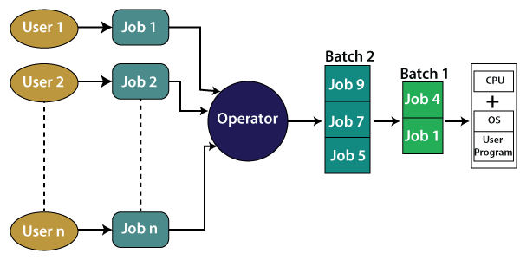
5. Types of operating System
Batch Operating System:
There is no direct interaction between user and computer.
The user needs to prepare jobs and save offline mode to punch card or paper tape or magnetic tape.
After creating the jobs, hand it over to the computer operator; then the operator sort or creates the similar types of batches like B2, B3, and B4.
Now, the computer operator submits batches into the CPU to execute the jobs one by one.
It is designed to execute one job at a time. Jobs are processed on a first-come, first-serve basis,
After that, CPUs start executing jobs, and when all jobs are finished, the computer operator provides the output to the user.
Example:
Credit Card Bill A separate bill is not generated for each credit card purchase, rather a single bill that includes all purchases in a month is generated through batch processing
-- Prof. Ashok Sadavare

Slide 18
5. Types of operating System
Batch Operating System:
Advantages of Batch processing operating system:
Repeated jobs can be completed easily without any human intervention
Hardware or system support is not required to input data in batch systems
It can work offline, so it causes less stress on the processor as it knows which task to process next and how long the task will last.
It can be shared among multiple users.
You can set the timing of batch jobs so that when the computer is not busy, it can start processing the batch jobs such as at night or any other free time.
Disadvantages of batch processing operating systems:
You need to train the computer operators for using the batch system.
It is not easy to debug this system.
If any error occurs in one job, the other jobs may have to wait for an uncertain time.
-- Prof. Ashok Sadavare

Slide 19
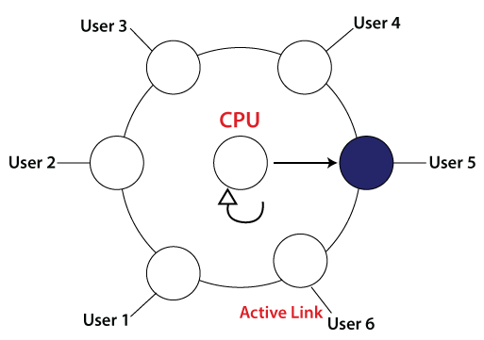
5. Types of operating System
Time-Sharing Operating System:
It allows us to connect many people located at different locations to share and use a specific system at a single time.
The time-sharing operating system is the logical extension of the multiprogramming through which users can run multiple tasks concurrently.
It provides each user his terminal for input or output that impacts the program or processor currently running on the system.
It represents the CPU's time (or processor's time) is shared between multiple users simultaneously termed as time-sharing.
-- Prof. Ashok Sadavare

Slide 20
5. Types of operating System
Time-Sharing Operating System:
Advantages of time sharing operating system:
It reduces CPU idle time and thus makes it more productive.
Each process gets the chance to use the CPU.
It allowed different applications run simultaneously.
Disadvantages of time sharing operating system:
It requires a special operating system as it consumes more resources.
Switching between tasks may hang up the system as it serves lots of users and runs lots of applications at the same time, so it requires hardware with high specifications.
It is less reliable.
-- Prof. Ashok Sadavare

Slide 21
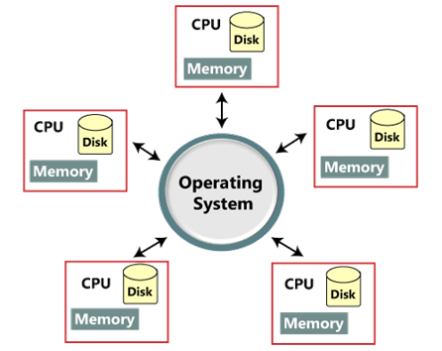
5. Types of operating System
Distributed operating System:
It uses multiple central processors to serve multiple users and to multiple real-time applications.
Data processing jobs are distributed among the processors accordingly.
The processors communicate with one another through various communication lines (such as high-speed buses or telephone lines).
It also referred as loosely coupled systems or distributed systems.
Processors in a distributed system may vary in size and function. These processors are referred as sites, nodes, computers, and so on.
The availability of powerful microprocessor and advanced communication technology have made it possible to design, develop, and use the distributed operating system.
-- Prof. Ashok Sadavare

Slide 22
5. Types of operating System
Distributed operating System:
Advantages of distributed operating system:
Its performance is higher than a single system as resources are being shared.
If one system stops working, malfunctions, or breaks down, other nodes are not affected.
Additional resources can be added easily.
Shared access to resources like printer can be established.
Delay in processing is reduced to a greater extent.
Data sharing or exchange speed is high, owing to the use of electronic mail.
Disadvantages of distributed operating system:
Security issue may arise due to sharing of resources
Few messages may be lost in the system
Higher bandwidth is required in case of handling a large amount of data
Overloading issue may arise
The performance may be low
The languages which are used to set up a distributed system are not well defined yet
They are very costly, so they are not easily available.
-- Prof. Ashok Sadavare

Slide 23
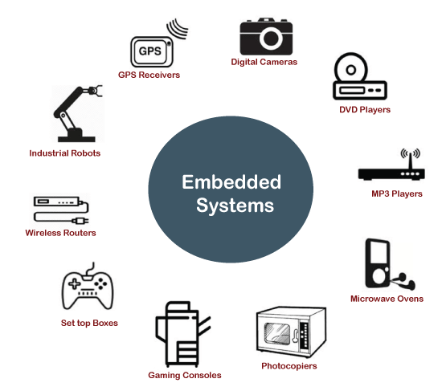
5. Types of operating System
Embedded Operating System:
The Embedded operating system is the specific purpose operating system used in the computer system's embedded hardware configuration.
These operating systems are designed to work on dedicated devices like automated teller machines (ATMs), airplane systems, digital home assistants, and the internet of things (IoT) devices.
-- Prof. Ashok Sadavare

Slide 24
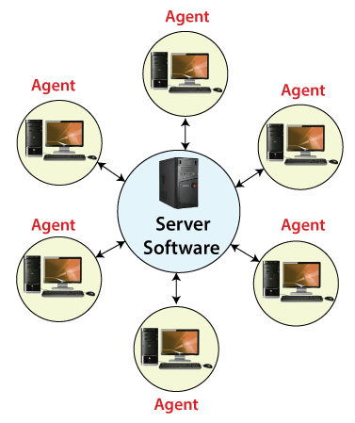
5. Types of operating System
Network Operating System:
A Network Operating System runs on a server and provides the server the capability to manage data, users, groups, security, applications, and other networking functions.
The primary purpose of the network operating system is to allow shared file and printer access among multiple computers in a network, typically a local area network (LAN), a private network or to other networks.
Examples: Microsoft Windows Server 2003, Microsoft Windows Server 2008, UNIX, Linux, Mac OS X, Novell NetWare, and BSD.
-- Prof. Ashok Sadavare

Slide 25
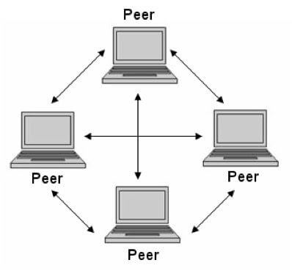
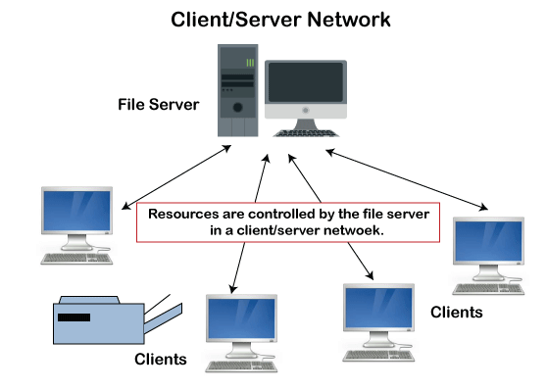
5. Types of operating System
Network Operating System:
Types of network operating system:
Peer-to-peer network operating system:
The type of network operating system allows users to share files, resources between two or more computer machines using a LAN.
Client-Server network operating system:
It is the type of network operating system that allows the users to access resources, functions, and applications through a common server or centre hub of the resources.
The client workstation can access all resources that exist in the central hub of the network.
Multiple clients can access and share different types of the resource over the network from different locations.
-- Prof. Ashok Sadavare

Slide 26
5. Types of operating System
Network Operating System:
Advantages of network operating system:
The servers are centralized that can be accessed remotely from distant locations and different systems.
It is easy to integrate advanced and recent technologies and hardware in this system.
Disadvantages of network operating system:
The servers used in the system may be expensive.
The system depends on the central location and requires regular monitoring and maintenance.
-- Prof. Ashok Sadavare

Slide 27
5. Types of operating System
Real-time Operating System:
It is developed for real-time applications where data should be processed in a fixed, small duration of time.
It is used in an environment where multiple processes are supposed to be accepted and processed in a short time.
RTOS requires quick input and immediate response
Example: in a petroleum refinery, if the temperate gets too high and crosses the threshold value, there should be an immediate response to this situation to avoid the explosion.
Similarly, this system is used to control scientific instruments, missile launch systems, traffic lights control systems, air traffic control systems, etc.
-- Prof. Ashok Sadavare

Slide 28
5. Types of operating System
Real-time Operating System:
This system is further divided into two types based on the time constraints:
Hard Real-Time Systems:
These are used for the applications where timing is critical or response time is a major factor; even a delay of a fraction of the second can result in a disaster.
For example, airbags and automatic parachutes that open instantly in case of an accident. Besides this, these systems lack virtual memory.
Soft Real-Time Systems:
These are used for application where timing or response time is less critical.
Here, the failure to meet the deadline may result in a degraded performance instead of a disaster.
For example, video surveillance (cctv), video player, virtual reality, etc. Here, the deadlines are not critical for every task every time.
-- Prof. Ashok Sadavare

Slide 29
5. Types of operating System
Real-time Operating System:
Advantages of real-time operating system:
The output is more and quick owing to the maximum utilization of devices and system
Task shifting is very quick, e.g., 3 microseconds, due to which it seems that several tasks are executed simultaneously
Gives more importance to the currently running applications than the queued application
It can be used in embedded systems like in transport and others.
It is free of errors.
Memory is allocated appropriately.
Disadvantages of real-time operating system:
A fewer number of tasks can run simultaneously to avoid errors.
It is not easy for a designer to write complex and difficult algorithms or proficient programs required to get the desired output.
Specific drivers and interrupt signals are required to respond to interrupts quickly.
It may be very expensive due to the involvement of the resources required to work.
-- Prof. Ashok Sadavare

Slide 30
6. Structures of operating System
A structure of an Operating System determines how it has been designed and how it functions.
There are following different ways of designing a new structure of an Operating system:
Monolithic systems
Layered systems
Microkernels
Exokernels
Client-server models
-- Prof. Ashok Sadavare

Slide 31
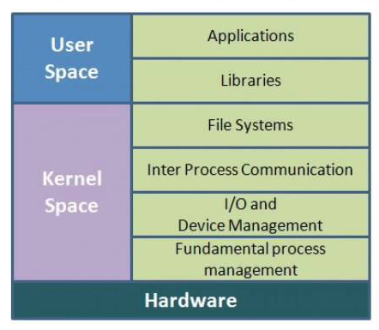
6. Structures of operating System
1. Monolithic systems:
The entire operating system works in the kernel space
This increases the size of the kernel as well as the operating system
The kernel provides various services such as memory management, file management, process scheduling etc. using function calls.
This makes the execution of the operating system quite fast as the services are implemented under the same address space.
A process runs completely in a single address space
The monolithic kernel is a static single binary file.
-- Prof. Ashok Sadavare

Slide 32
6. Structures of operating System
Disadvantages Monolithic systems :
If any service fails, it leads to the failure of the entire system.
To add any new service, the entire operating system needs to be modified by the user.
-- Prof. Ashok Sadavare

Slide 33
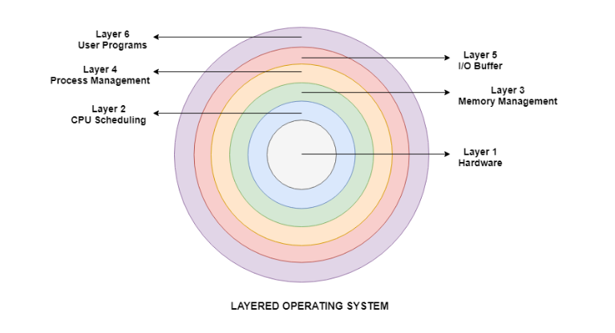
6. Structures of operating System
2. Layered systems:
The operating system is split into various layers
Each of the layers have different functionalities.
This type of operating system was created as an improvement over the early monolithic systems.
All the layers can be defined separately and interact with each other as required.
Each of the layers in the operating system can only interact with the layers that are above and below it.
The lowest layer handles the hardware and the uppermost layer deals with the user applications.
It is easier to create, maintain and update the System.
Change in one layer specification does not affect the rest of the layers.
-- Prof. Ashok Sadavare

Slide 34
6. Structures of operating System
Layered systems Layers:
Hardware:
This layer interacts with the system hardware and coordinates with all the peripheral devices
The hardware layer is the lowest layer in the layered operating system architecture.
CPU Scheduling
This layer deals with scheduling the processes for the CPU
There are many scheduling queues that are used to handle processes.
When the processes enter the system, they are put into the job queue.
The processes that are ready to execute in the main memory are kept in the ready queue.
Memory Management
Memory management deals with memory and the moving of processes from disk to primary memory for execution and back again.
This is handled by the third layer of the operating system.
-- Prof. Ashok Sadavare

Slide 35
6. Structures of operating System
Layered systems:
Process Management
This layer is responsible for managing the processes i.e. assigning the processor to a process at a time. This is known as process scheduling.
The different algorithms used for process scheduling are FCFS (first come first served), SJF (shortest job first), priority scheduling, round-robin scheduling etc.
I/O Buffer
I/O devices are very important in the computer systems
They provide users with the means of interacting with the system
This layer handles the buffers for the I/O devices and makes sure that they work correctly.
User Programs
This is the highest layer in the layered operating system
This layer deals with the many user programs and applications that run in an operating system such as word processors, games, browsers etc.
-- Prof. Ashok Sadavare

Slide 36
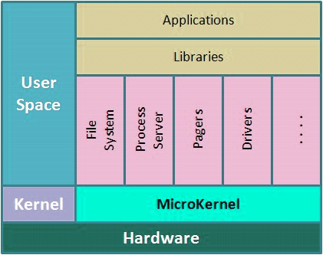
6. Structures of operating System
3. Microkernel systems:
A microkernel is the minimum software that is required to correctly implement an operating system.
The microkernel contains basic requirements such as memory, process scheduling mechanisms and basic inter-process communication
The other functions (device drivers, file servers, application inter-process communication etc.) of the operating system are removed from the kernel mode and run in the user mode.
Microkernels are modular and the different modules can be replaced, reloaded, modified, changed etc. as required.
Microkernels are quite
Microkernels contain fewer system crashes as compared to monolithic systems
-- Prof. Ashok Sadavare

Slide 37
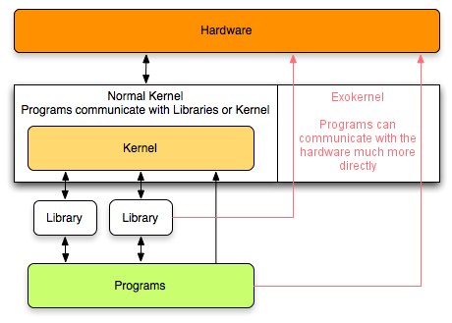
6. Structures of operating System
4. Exokernel systems:
Exokernels are a subset of virtual machines.
The disks are actually partitioned, and resources are allocated while setting it up.
The different OS may be installed on different partitions.
Better support for application control
Separates security from management
Abstractions are moved securely to an untrusted library operating system
Provides a low-level interface
Library operating systems offer portability and compatibility
Improved performance of applications
More efficient use of hardware resources
-- Prof. Ashok Sadavare

Slide 38
6. Structures of operating System
5. Client-Server Model:
Client/Server communication involves two components, namely a client and a server.
They are usually multiple clients in communication with a single server.
Client/Server communication involves two components, namely a client and a server.
-- Prof. Ashok Sadavare

Slide 39
6. Structures of operating System
Client-Server Model:
Three main methods to client/server communication:
1. Sockets method :
Sockets facilitate communication between two processes on the same machine or different machines. They are used in a client/server framework and consist of the IP address and port number.
-- Prof. Ashok Sadavare

Slide 40
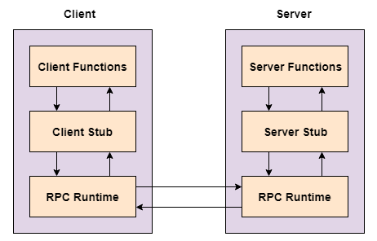
6. Structures of operating System
Client-Server Model:
2. Remote Procedure Calls Method
These are inter-process communication techniques that are used for client-server based applications.
A remote procedure call is also known as a subroutine call or a function call.
A client has a request that the RPC translates and sends to the server.
This request may be a procedure or a function call to a remote server.
When the server receives the request, it sends the required response back to the client.
-- Prof. Ashok Sadavare

Slide 41
6. Structures of operating System
Client-Server Model:
3. Pipes Method
These are inter-process communication methods that contain two end points.
Data is entered from one end of the pipe by a process and consumed from the other end by the other process.
The two different types of pipes:
Ordinary pipes: Ordinary pipes only allow one way communication.
Named pipes: Named pipes allow two way communication.
-- Prof. Ashok Sadavare

Slide 42
Q & A
Introduction to Programming using ‘C’
-- Prof. Ashok Sadavare

Slide 43
Thank You..
Introduction to Programming using ‘C’
-- Prof. Ashok Sadavare

